Slide 1
Parallel String Matching
Using OpenMP and MPI
By Ramkumar Rajabaskaran & Sindhuri Rayavaram

Slide 2
Problem Statement
String matching algorithm are used for finding substrings in strings.
Given Pattern(1...p) and Text (1..m) defined over alphabet ∑, find all the occurrences of P in T.
Uses:
Web searches, Queries, DNA Pattern Matching

Slide 3
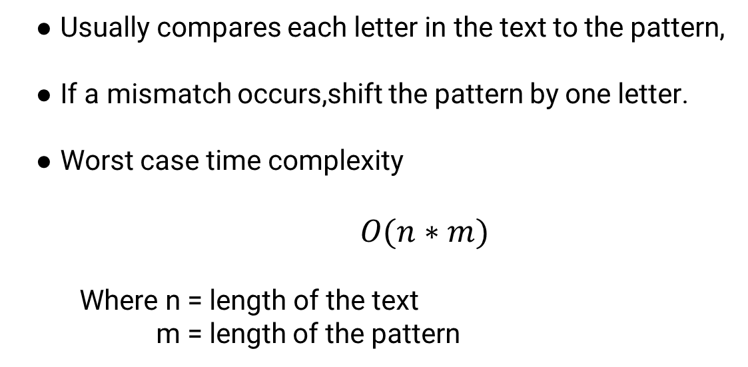
Naive Algorithm and Analysis
Usually compares each letter in the text to the pattern,
If a mismatch occurs,shift the pattern by one letter.
Worst case time complexity
$$O(n∗m)$$
Where n = length of the text
m = length of the pattern

Slide 4
Boyer Moore Horspool Algorithm
Create a ‘Bad Match Table’
Value = length-index-1
Starting from the rightmost character in the pattern, start comparing the pattern to text
If a mismatch occurs, move the pattern forward corresponding to the value of last character of the text from the table.

Slide 5
Implementation

Slide 6
Implementation
PATTERN :- EATER
TEXT :- IAMPETERTHEANTEATER
Bad Match Table :- Value = Length - Index - 1 ; Last character Value = Length
For all other characters, Value = Length.
Letter | E | A | T | R | All other
Index | 0,3 | 1 | 2 | 4 | ---
Value | 1 | 3 | 2 | 5 | 5

Slide 7
Implementation
I | A | M | P | E | T | E | R | T | H | E | A | N | T | E | A | T | E | R
E | A | T | E | R
Mismatch ! Shift by 1 ( E )
I | A | M | P | E | T | E | R | T | H | E | A | N | T | E | A | T | E | R
 | E | A | T | E | R
Mismatch ! Shift by 2 ( T )

Slide 8
Implementation
I | A | M | P | E | T | E | R | T | H | E | A | N | T | E | A | T | E | R
 |  |  | E | A | T | E | R
Mismatch ! Shift by 5 ( R )
I | A | M | P | E | T | E | R | T | H | E | A | N | T | E | A | T | E | R
 |  |  |  |  |  |  |  | E | A | T | E | R
Mismatch ! Shift by 5 ( N )

Slide 9
Implementation
I | A | M | P | E | T | E | R | T | H | E | A | N | T | E | A | T | E | R
 |  |  |  |  |  |  |  |  |  |  |  |  | E | A | T | E | R
Mismatch ! Shift by 1 ( E )
I | A | M | P | E | T | E | R | T | H | E | A | N | T | E | A | T | E | R
 |  |  |  |  |  |  |  |  |  |  |  |  |  | E | A | T | E | R
Match Found !!!

Slide 10
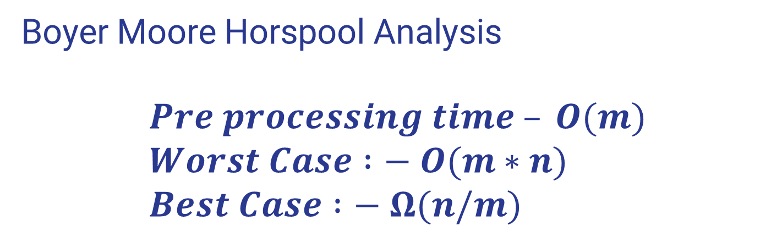
Boyer Moore Horspool Analysis $$Pre processing time – O(m) \\ Worst Case :− O(m∗n) \\ Best Case :− Ω(n/m)$$

Slide 11
Sequential Implementation
Pattern Length is inversely proportional to Time .
Input size 91,626,971 characters

Slide 12
OpenMP Implementation
The file is divided into blocks
Blocksize = filesize/number of threads
Index the threads and make them work on different blocks.
Set an offset to avoid the split case of pattern between the blocks.
We use #pragma omp reduce to sum the individual counts of the threads.

Slide 13
OpenMP results
Speedup for OpenMP is close to 15 for 64 threads. Input size is 91,626,971

Slide 14
MPI Implementation
The file is divided into blocks.
Blocksize = Filesize/number of processors
Each processor is working on different blocks.
We used MPI_File_read_at_all which reads a block from a given position.
MPI Reduce is used to get the count of the occurences
Offset is used to take care of the split pattern case

Slide 15
MPI Results
Input size is
91,626,971 characters
Processors = 64

Slide 16
Observation & Analysis
OpenMP provides a good implementation and speedup for this algorithm.
MPI algorithm provides a better result for lesser number of processers.
MPI_File_read_at_all(collective), MPI_File_read_at are blocking .
MPI_File_iread is nonblocking and still didn’t give better speedup.

Slide 17
Observation and Analysis
If we consider the performance of the algorithm itself, it is implemented faster than the Sequential code for both MPI and OpenMP
The bottleneck in the MPI is in reading the file.

Slide 18
THANK YOU

